Slide 1
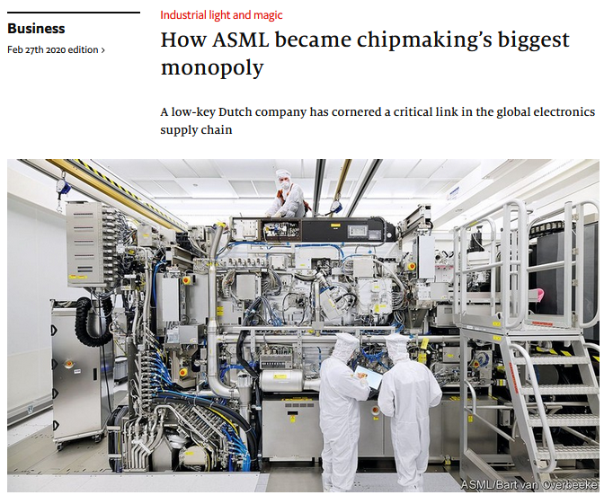
MOT1421: Economic Foundations Week 2: Monopoly
Example:
ASML, the world’s
sole manufacturer
of the most
advanced equipment
critical to
modern chipmaking.
ASML is not the only
maker of photolithographic
machines, which use
light to etch integrated
circuits onto silicon wafers, but
It alone has harnessed extreme
ultraviolet light with wavelengths
of just 3.5 nanometres.

Slide 2
MOT1421: Economic Foundations Week 2: Monopoly
Assumptions:
Large number of buyers (same as in perfect competition)
One supplier = the monopolist with price-setting power
Only 1 product; no product differentiation
Entry is blocked (not possible); perfect information
The monopolistic firm is assumed to maximise profits
Buyers (consumers) also have “power”: they are only willing to buy more if the price P is lower → market demand function:
Q = a₀* – a₁* x P

Slide 3
MOT1421: Economic Foundations Week 2: Monopoly
The monopolistic firm has the power to set the price.
But if it increases the price, the quantity demanded Q will decrease. Alternatively, if the firm sets the quantity supplied, the market price P is determined. Why?
Because of the market demand function: Q = a₀* – a₁* x P
(the demand function is based on consumer preferences; note: consumers are sovereign ..........)
The monopolist is “powerful”, but it cannot set a high P and supply a high Q (because buyers will buy less at a high P, and vice versa). The price P and the quantity supplied Q are mutually dependent, and this complicates the problem for the monopolist.

Slide 4
MOT1421: Economic Foundations Monopoly
Profit maximisation by the monopolistic firm
Profits = Π(Q) = TR(Q) – TC(Q)
Total Revenue = TR(Q) = P*Q
Total Cost = TC(Q) , i.e. TC are a function of the level of output Q
The (first-order) condition for maximum profits: dΠ/dQ = 0
→ dTR/dQ – dTC/dQ = 0 → dTR/dQ = dTC/dQ → MR = MC
Thus: the monopolist maximises Π by producing at the profit-maximising level of output Q*
at which marginal revenue = marginal cost

Slide 5
MOT1421: Economic Foundations Monopoly
The condition for maximum profits: MR = MC .
Let us consider MARGINAL REVENUE of the monopolist:
Total revenue = TR = P*Q
We know that market demand is: Q = a₀* – a₁* x P [ Q is a function of P, and vice versa]
P = (a₀*/ a₁*) – (1/ a₁*) = a₀ – a₁ x Q [a₀ = (a₀*/ a₁*) ; a₁ = 1/ a₁* ]
Therefore: TR = P*Q = [a₀ – a₁ x Q] x Q = a₀ x Q – a₁ x Q^2
MR = a₀ – 2 x a₁ x Q [ MR declines when Q rises; MR is not constant]

Slide 6
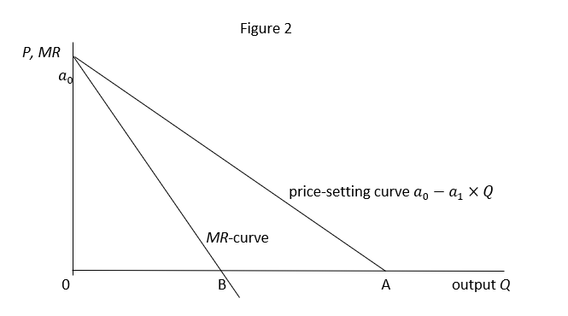
MOT1421: Economic Foundations Monopoly
The linear demand
curve and the
corresponding
marginal
revenue curve

Slide 7
MOT1421: Economic Foundations Monopoly
Let us now consider Marginal Cost of the Monopolist:
TC = b₀ + b₁ x Q [ simplified linear TC-function]
MC = (d TC/ dQ) = b₁
The condition for maximum profits: MR = MC →
MR = a₀ – 2 x a₁ x Q = MC = b₁
Hence: the profit-maxmising level of output Q* = ( a₀– b₁)/2a₁
The profit-maximising P* = a₀ – a₁ x Q* = ½ a₀ + ½ b₁
Supernormal Π* = TR – TC = [ (a₀–b₁) ]²/4a₁ – b₀

Slide 8
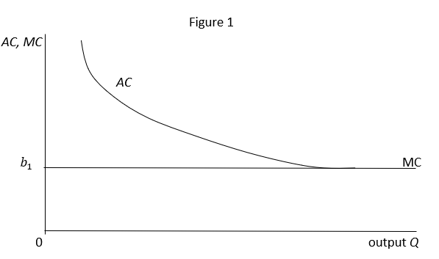
MOT1421: Economic Foundations Monopoly
Average cost (AC)
Marginal cost (MC)

Slide 9
MOT1421: Economic Foundations Monopoly: numerical example
Market demand Q = 80 – 2P and TC = 30 + 2Q
Step 1: deriving MR
Q = 80 – 2P → P = 40 – ½Q → TR = P x Q = 40Q – ½Q² → MR = 40 – Q
Step 2: deriving MC
TC = 30 + 2Q → MC = 2
Step 3: deriving profit-maximising level of output Q* and price P*
MR = MC → 40 – Q = 2 → Q* = 38 → P* = 40 – ½Q* = 21
Step 4: deriving maximum supernormal profits
Π* = TR – TC = P*xQ* - TC = 798 – 106 = 692 > 0

Slide 10
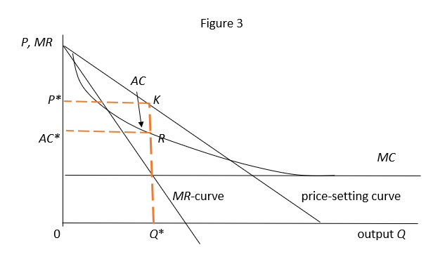
MOT1421: Economic Foundations Monopoly: graph Supernomal profits = area AC*RKP*

Slide 11
MOT1421: Economic Foundations Monopoly: static efficiency versus dynamic efficiency
Static efficiency: is defined in terms of ‘consumer welfare’.
Consumer welfare depends on the price at which the good can be bought and the number of goods in the market
Static efficiency is highest in PERFECT COMPETITION (long-run), because P = AC (lowest possible level) and market supply is relatively high.
Static efficiency is lowest in MONOPOLY, because P > AC (maximum supernormal profits) and market supply is restricted. (Consumers pay a high P for a relatively low quantity of supply).

Slide 12
MOT1421: Economic Foundations Monopoly: static efficiency versus dynamic efficiency
Dynamic efficiency: the capacity of firms to lower AC over time and to develop new goods & services → INNOVATION and technical progress
Innovation & technical progress require (large) investments and the future returns to innovation are uncertain.
SCHUMPETER:
Firms in Perfect Competition cannot innovate because P = AC (they only have normal profits) and cannot take risk. Dynamic efficiency is low.
A firm in (temporary) Monopoly and Oligopoly has the internal funds to invest in innovation, because P > AC (supernormal profits); it can also bear the risk. Dynamic efficiency will be higher.
Qualification: if the monopoly = permanent, then the monopolist may “enjoy a good life” at the cost of consumers ..........

